Slide 1
ASU Presentation Test

Slide 2
Jalal Kiswani
Command: # Heading :
Description: This command add heading to the document
Example:
# Main Title
Output:
Include Screenshot of the output

Slide 3
MAHMOUD ALSHAEYB
Comand

Slide 4
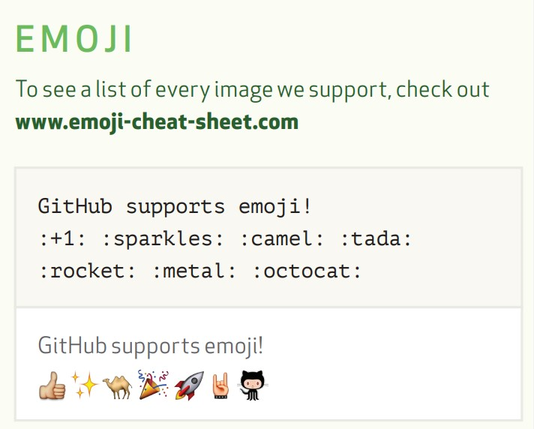
IBRAHIM MOHAMMAD
*****

Slide 5
Ahmad Abughbosh
Highlight
Command: ==Highlight==, Subscript
Example:
I need to highlight these ==very important words==
==ASU==
H~2~O
Results:
I need to highlight these very important words ASU
H₂O

Slide 6

Musaab
Strikethrough
~~The world is flat.~~
The world is flat.

Slide 7
Ahmad Mustafa
Command: Definition
Description: This command for explaining a definition
Example:
Term
: definition
Output:

Slide 8
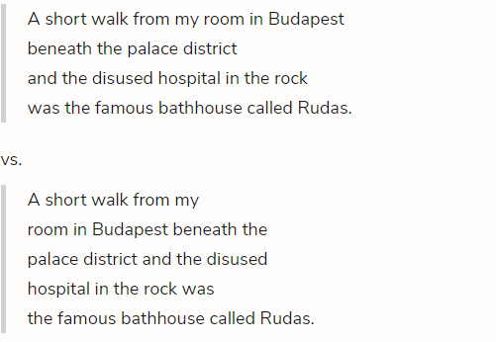
Khalifa Altawil
Command: (<br>)
Description: This command is
used to break lines.
Example:This
Is

Slide 9
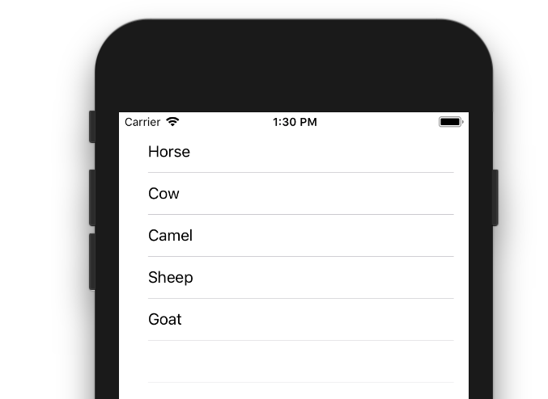
Mahmoud Samarah
# Tables
—
The view controller adopts the UITableViewDelegate and UITableViewDataSource protocols.
The numberOfRowsInSection method determines how many rows there will be in the table view.
The cellForRowAtIndexPath method sets up each row.
The didSelectRowAtIndexPath method is called every time a row is tapped.
Output:

Slide 10

Ahmad AbuZaid
Bold text (**( )**)
To bold text, add two asterisks or underscores before and after a word or phrase. To bold the middle of a word for emphasis, add two asterisks without spaces around the letters.
Ex: I just love **bold text**.
Output

Slide 11

Abdullrahman Ghazal

Slide 13

Batool
Command: link
Example:[ASU](https://edugate.asu.edu.jo/)
OutPut:

Slide 14

Ayman Harb
Command: Style
Description : change the style of the text
Example :
***Ayman Harb***
Output :

Slide 15
Athamneh
Command: # Heading :
Description: This command add heading to the document
Example:
# Main Title
Output:
Include Screenshot of the output
Notes:
nothing

Slide 16
Jawad
Command :<ol>
Example :

